Slide 1
Chapter-1
Introduction to Management

Slide 2
Topics
Management - Key concepts
Levels of Management
Organizational Performance
Managerial Functions
Managerial Roles
Managerial Skills
Skills in different Level
Management Challenges

Slide 3




Manager & Management
Organizations comprises of People working together and coordinating their actions to achieve specific goals.
Manager is someone who coordinates and oversees the work of other people so that organizational goals and objectives can be accomplished.
Goal: A desired future condition that the organization seeks to achieve.
Management in all business areas and organizational activities are the acts of getting people together to accomplish desired goals and objectives.

Slide 4
BUSINESS OPERATIONS OVERLAP
Operations
Marketing
Finance

Slide 5
OPERATIONS INTERFACES
Engineering
Maintenance
Distribution
Purchasing
Public
Relations
Operations
Legal
Personnel
Accounting
MIS

Slide 6
Three Levels of Management
Top Managers
Middle Managers
First-line Managers
Non-management

Slide 7
Classifying Managers
First-line Managers
  Individuals who manage the work of non-managerial employees.
Middle Managers
  Individuals who manage the work of first-line managers.
Top Managers
  Individuals who are responsible for making organization-wide decisions and establishing plans and goals that affect the entire organization.

Slide 8
Organizational Performance
Measures how efficiently and effectively managers use resources to satisfy customers and achieve goals.
  Efficiency: A measure of how well resources are used to
  achieve a goal. Usually, managers must try to minimize the
  input of resources to attain the same goal.
    Effectiveness: A measure of the appropriateness of the goals chosen (are these the right goals?), and the degree to which they are achieved.
    Organizations are more effective when managers choose the correct goals and then achieve them.

Slide 9
Efficiency and Effectiveness
  Efficiency
    -“Doing things right”
      Getting the most output for the least inputs
  Effectiveness
    -“Doing the right things”
      Attaining organizational goals

Slide 10
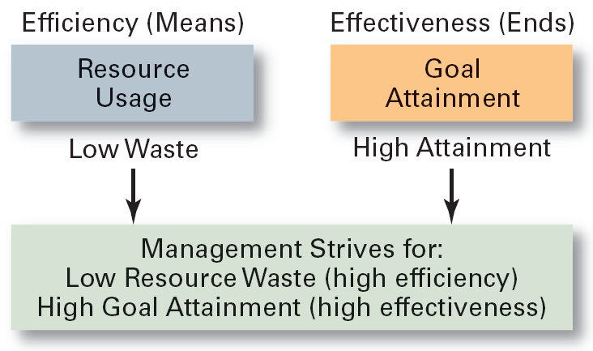
Efficiency and Effectiveness

Slide 11
Managerial Functions
Henri Fayol was the first to describe the four managerial functions who was a French businessman.
Managers at all levels, operating in a for profit or not for profit organization, must perform each of the functions of:
  Planning,
  organizing,
  leading,
  controlling.

Slide 12
THE FUNCTIONS OF MANAGEMENT (CONTD.)
Leading
Organizing
Controlling
Planning

Slide 13
Planning
Planning is the process used by managers to identify
and select appropriate goals and courses of action
for an organization.
Questions answered by planning :
  1. Which goals should be pursued?
  2. How should the goal be attained?
  3. How should resources be allocated?

Slide 14
Organizing
In organizing, managers make arrangement and structuring of works to help members to work
together.
Through organizing Managers determine:
  What tasks are to do, who to do, how the tasks are to be grouped, line of authority, decision point and responsibility for members.
An organizational structure is the outcome of organizing. This structure guides, coordinates and motivates employees

Slide 15
Leading
In leading, managers provides direction, and help employees understand the role
Leadership involves selecting, hiring, motivating, resolving conflict, influencing action, persuasion, and effective communication.
The outcome of the leading function is a high level of motivation and commitment from employees to the organization.

Slide 16
Controlling
In controlling, managers evaluate how well the organization is achieving its goals and takes corrective action to improve performance.
Managers will monitor, compare and correct to determine if desired performance has to be reached
The outcome of the controlling function is the accurate measurement and improvement of performance

Slide 17
Managerial Roles
Described by Mintzberg.
  A role is a set of specific tasks a person performs because of the position they hold.
Roles are directed inside as well as outside the organization.
There are 3 broad role categories:
  1. Interpersonal
  2. Informational
  3. Decisional

Slide 18
Interpersonal Roles
Roles managers assume to coordinate and interact with employees and provide direction to the organization.
  Figurehead role: symbolizes the organization and what it is trying to achieve.
  Leader role: train, counsel, mentor and encourage high employee performance.
  Liaison role: maintains outside network and receives favor and information from them

Slide 19
Informational Roles
Associated with the tasks needed to obtain and transmit information for management of the organization.
  Monitor role: analyzes information from both the internal and external environment.
  Disseminator role: transmits information from outsiders or subordinates to member of organizations
  Spokesperson role: transmits information to outsides about the organization

Slide 20
Decisional Roles
Role of decision making
  Entrepreneur role: deciding upon new projects or programs to initiate and invest.
  Disturbance handler role: assume responsibility for handling an unexpected event or crisis.
  Resource allocator role: assign resources between functions and divisions, set budgets of lower managers.
  Negotiator role: seeks to negotiate solutions between other managers, unions, customers, or shareholders.

Slide 21
Managerial Skills
There are three skill sets that managers need to perform effectively.
  1. Conceptual skills: the ability to analyze and diagnose a situation and find the cause and effect.
  2. Human skills: the ability to understand, alter, lead, and control people’s behavior.
  3. Technical skills: the job-specific knowledge required to perform a task. Common examples include marketing, accounting, and manufacturing.

Slide 22
Skill Type Needed by Manager Level
Top
Managers
Middle
Managers
Line
Managers
Conceptual
Human
Technical

